Slide 1

cv
Night Vision Imagery: Fusion of low-light visible and thermal IR images
Team Members
Nitin P Khatawate
Soumil Biswas
ShivPrasad Achari
Tanish V Sugnani
Under the Guidance of:
Dr. Shubha Bhat Mr. Sasidhar B
Associate Professor, Asst. Professor,
Dept. of CSE Dept. of CSE
Department of Computer Science & Engineering, DSCE

Slide 2
Contents
Introduction
Flowchart
Code Snippet
Functions Used
Input and Output images

Slide 3
cv
INTRODUCTION
In computer vision, Multisensor Image fusion is the process of combining relevant information from two or more images into a single image. The resulting image will be more informative than any of the input images.
Real-time implementation of the dual sensor fusion system combines imagery from either a low-light CCD camera or a short-wave infrared camera, with thermal long-wave infrared imagery.
Department of Computer Science & Engineering, DSCE

Slide 4
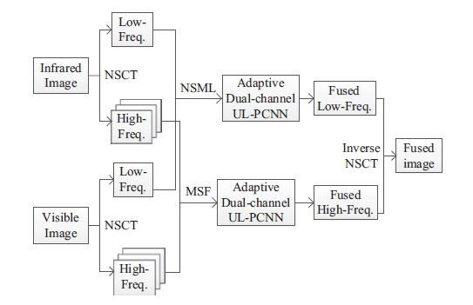
cv
FLOWCHART
Department of Computer Science & Engineering, DSCE

Slide 5
cv
CODE SNIPPET
Dual-channel PCNN
for(itime=1:10)
for(i=1:ROW)
for(j=1:COL)
if(JUDFIR(i,j)~=1)
HA=IMAWT(i,j)+IMA(i,j);
HB=IMBWT(i,j)+IMB(i,j);
U(i,j)=(1+BETA*HA)*(1+BETA*HB)+DELTA;
if (U(i,j)>THR(i,j))
JUDFIR(i,j)=1;
else
THR(i,j)=THR(i,j)*exp(-ALPHAT);
end
end %%% end of JUDFIR
end %%% end j
end %%% end i
Department of Computer Science & Engineering, DSCE

Slide 6
cv
FUNCTIONS USED
imread :-
Read image from graphics file
ex:A = imread(filename)
imshow(I) :-
Displays image I in a figure
conv2(2-D convolution) :-
In applications such as image processing, it can be useful to compare the input of a convolution directly to the output. The conv2 function allows you to control the size of the output.
Department of Computer Science & Engineering, DSCE

Slide 7
cv
PERFORMANCE METRICS
Corr2
2-D correlation coefficientcollapse all in page
Syntax – r = corr2(A,B)
Description
r = corr2(A,B) returns the correlation coefficient r between A and B, where A and B are matrices or vectors of the same size. r is a scalar double.
Examples
Compute the correlation coefficient between an image and the same image processed with a median filter.
I = imread('pout.tif');
J = medfilt2(I);
R = corr2(I,J)
Department of Computer Science & Engineering, DSCE

Slide 8
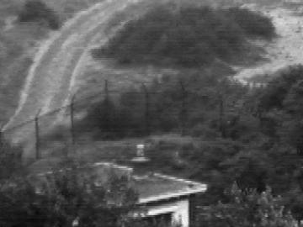
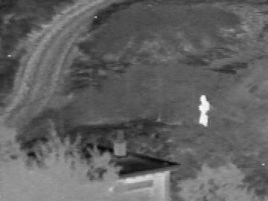
INPUT IMAGES
Visible Image
IR Image

Slide 9
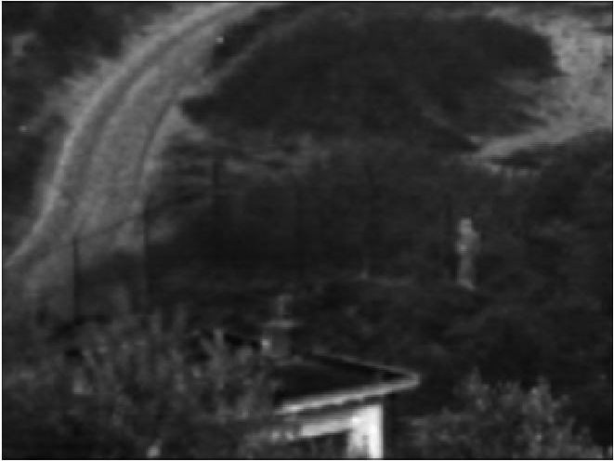
cv
Output
Department of Computer Science & Engineering, DSCE

Slide 10
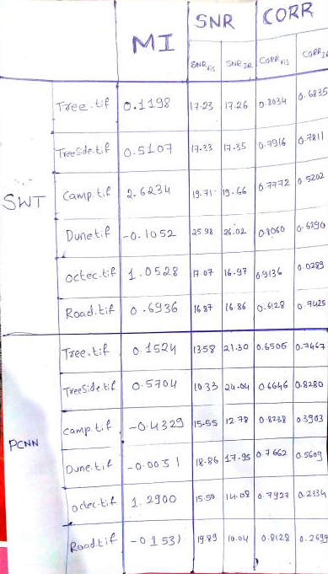

Slide 11
cv
THANK YOU
Department of Computer Science & Engineering, DSCE

